Slide 1
Apex Banking Portal
Guided By :
Mohammed Zaid

Slide 2
Table Of Contents
01
02
03
04
05
06
Introduction
Module
Design Overview
More Functionalities
Tools & Technologies
Conclusion

Slide 3
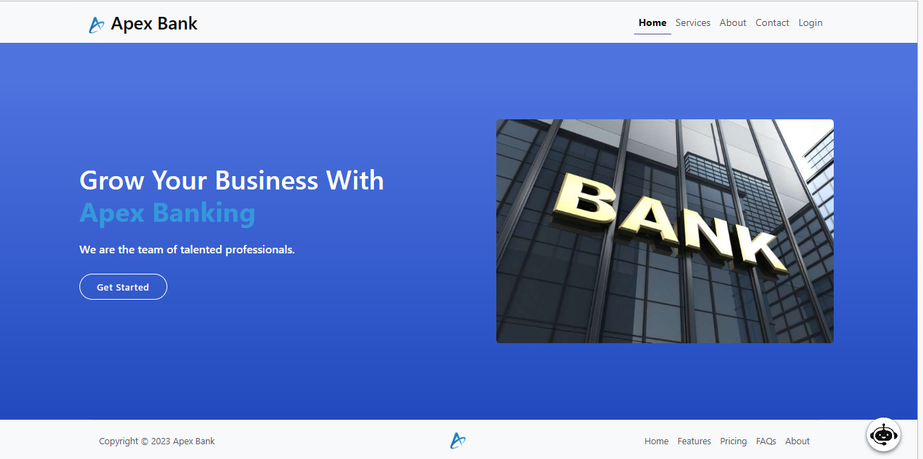

Introduction
Welcome to Apex Banking, we are thrilled to present this core banking project. Our goal is to deliver exceptional banking services and experiences to our customers.
By implementing a modern and integrated core banking system, we aim to revolutionize our operations, driving efficiency and innovation.
Join us on this exciting journey as we shape the future of banking, driven by a passion to provide the best possible experience. Together, let's build a stronger and more prosperous tomorrow.

Slide 4

Module
Customer
Employee
Vendor
Team Leader
Admin

Slide 5
Services
Transaction Service
Loan Service
Locker Service
Credit Card Service
Gift Card Service
Mark Productivity
Productivity Review
Retrieve Reports

Slide 6

Transaction
A transaction involves transferring funds or exchanging money between accounts.
Users can review their transaction history to track spending, monitor incoming and outgoing funds, and identify unauthorized activity.
This ensures greater financial awareness and security.
Our banking portal offers real-time transaction alerts via email, providing an additional layer of security by notifying users of any suspicious activities.

Slide 7
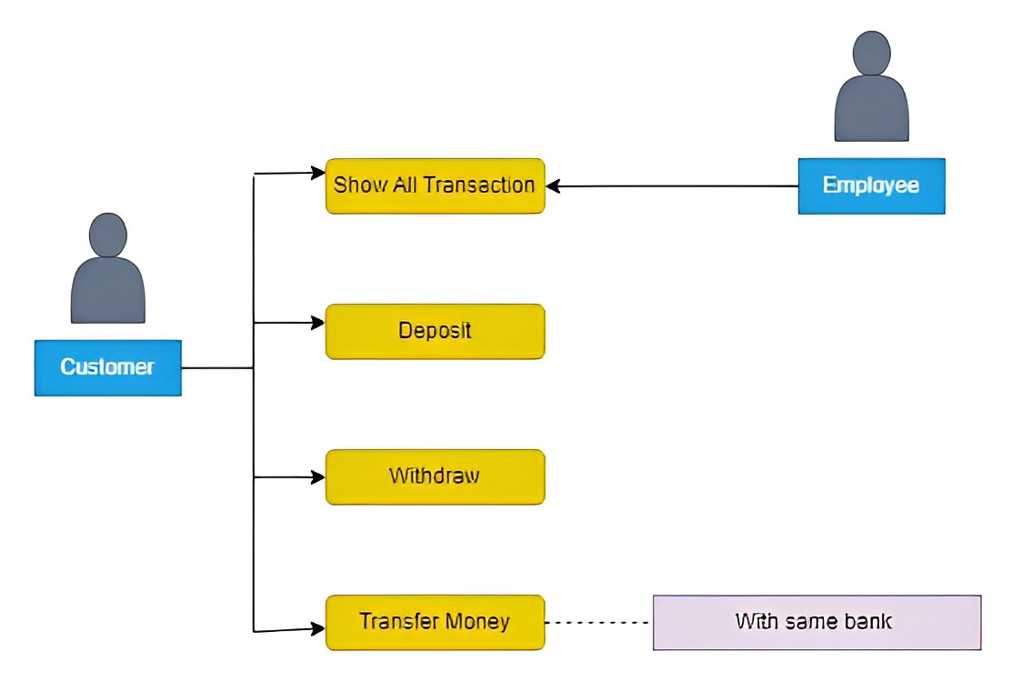
Transaction Service

Slide 8

Loan
Our banking portal offers various types of loans: personal, home, car, education, and business loans.
Customers apply by filling a form with loan type, duration, and amount.
After approval, customers manage repayments and EMIs through the portal.
Customers can track their loan application status online for updates on approval and disbursement.

Slide 9
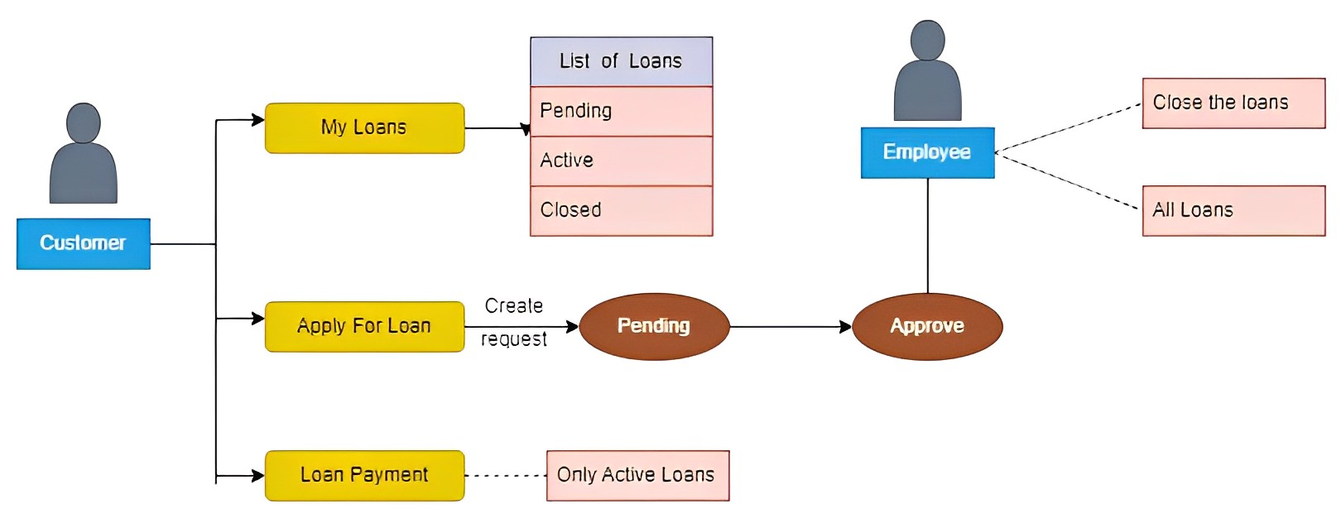
Loan Service

Slide 10

Locker
Our banking portal offers secure locker services for valuable items and documents.
Customers can select locker size, location, and apply electronically, reducing paperwork and visits.
Closing a locker is easy through the online portal, with customers specifying the closure date.
Online payment options simplify locker rental payments and reduce administrative work.

Slide 11
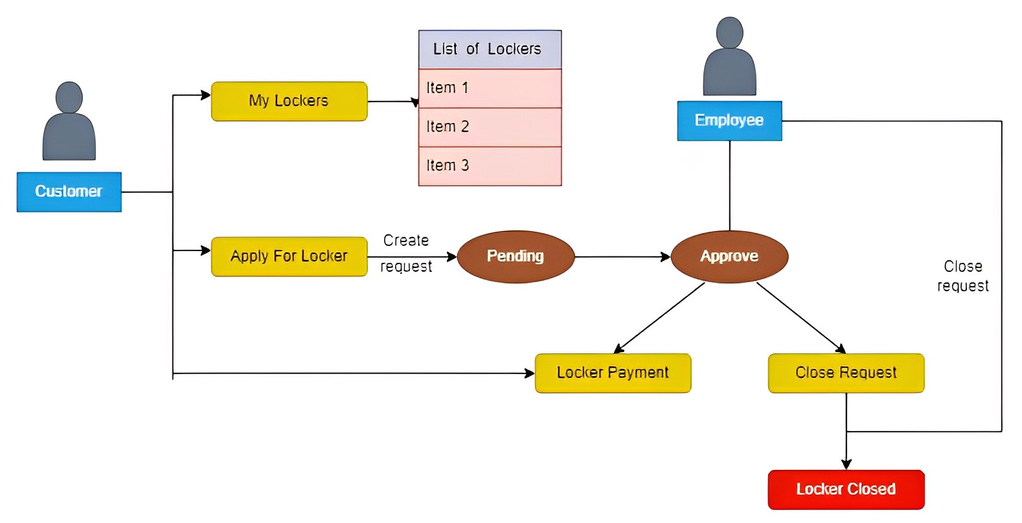
Locker Service

Slide 12

Credit Card
Our banking portal offers credit card services for easy access, management, and transactions.
Customers can view and control their credit card usage through the digital platform.
Detailed credit card account information is readily available on the our banking portal.

Slide 13
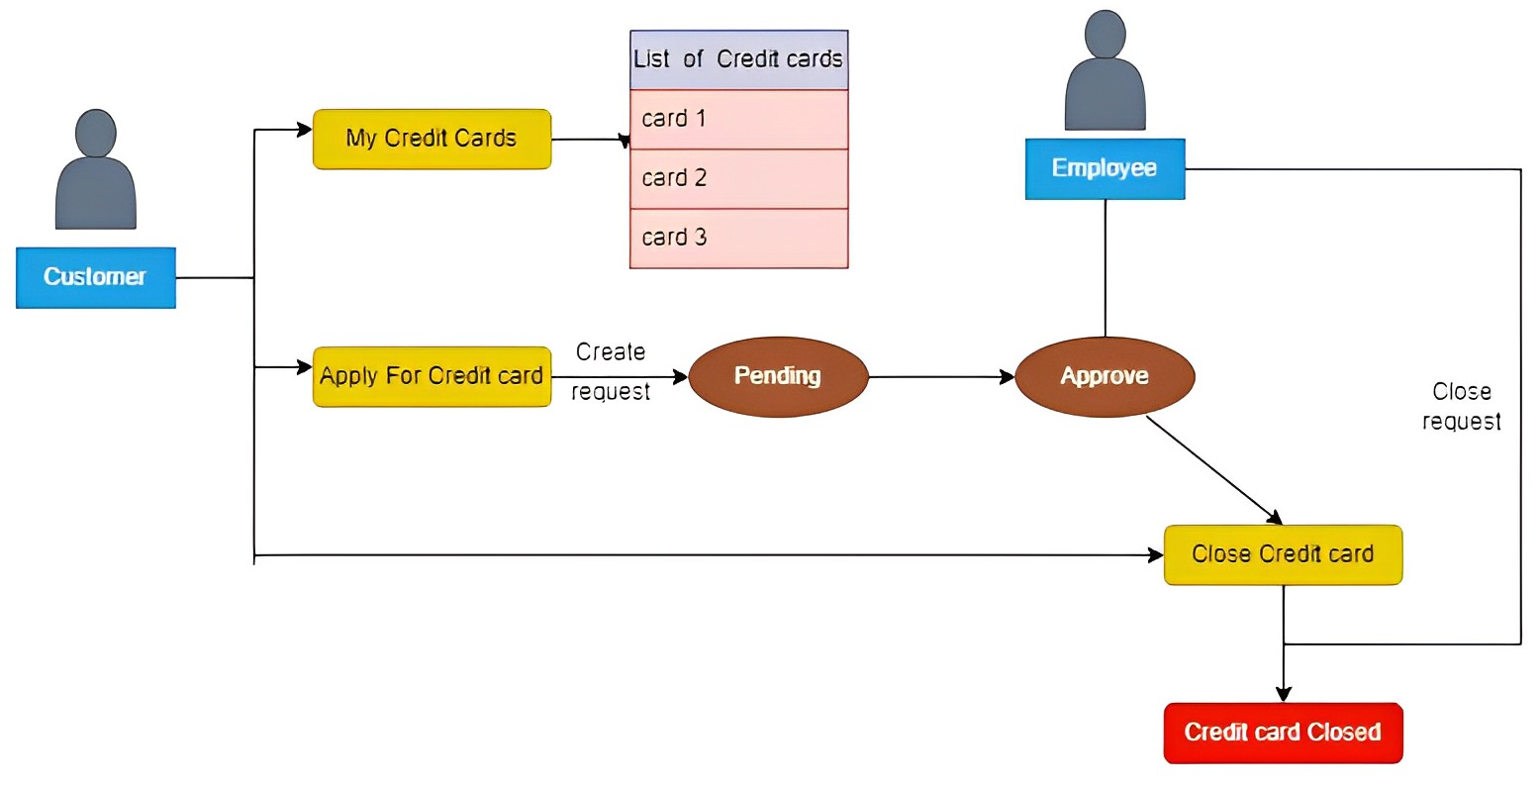
Credit Card Service

Slide 14

Gift Card
Our banking portal offers a gift card service for easy purchase, management, and use.
Customers can buy gift cards with desired values and recipient details conveniently.
The portal enables managing purchased gift cards, including checking balances and viewing transaction history.

Slide 15
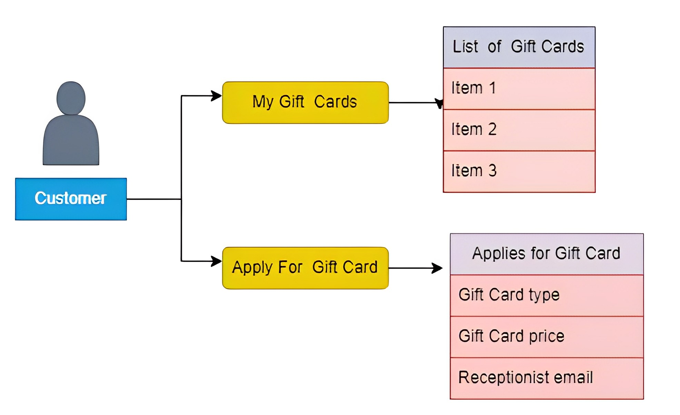
Gift Card Service

Slide 16
Vendor Productivity Management
The Vendor Productivity Management Tool is a web-based utility designed to track and manage productivity for vendors working on specific projects.
The tool allows vendors to log in using their Active Directory (AD) credentials and mark their daily actions and deliverables. The tool provides various features, including marking productivity, approving productivity, generating reports, and managing user accounts.

Slide 17
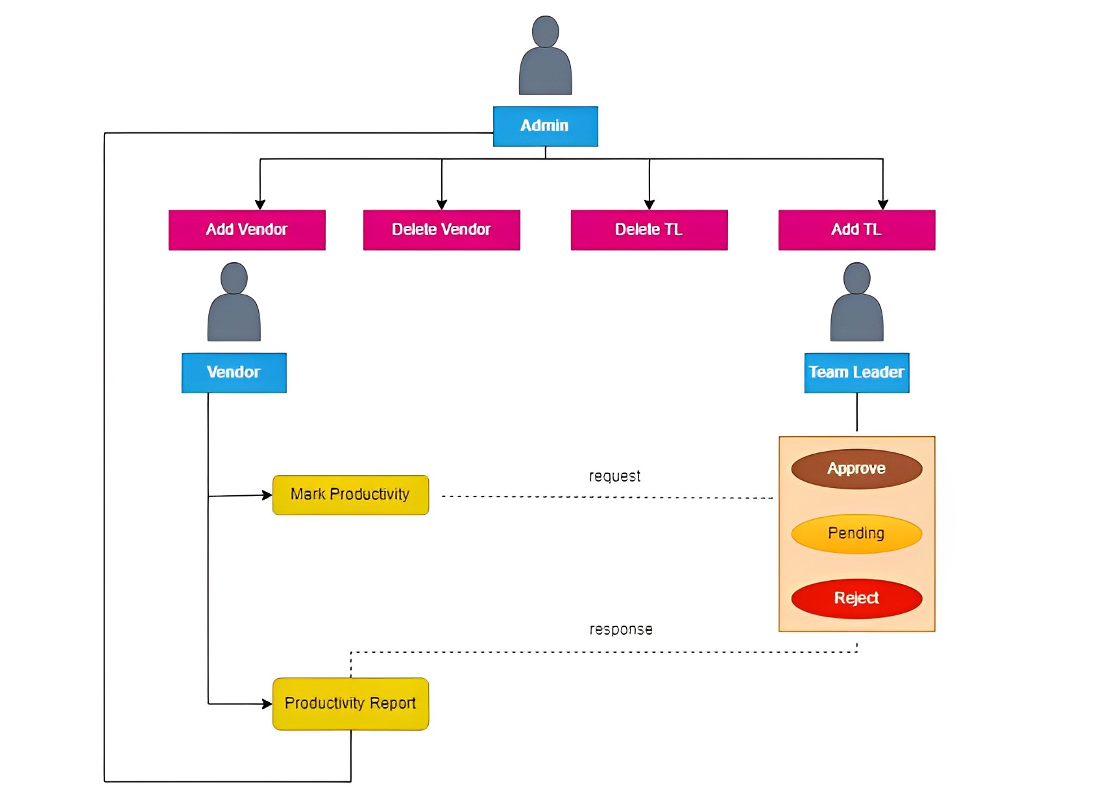
Vendor Productivity Management

Slide 18
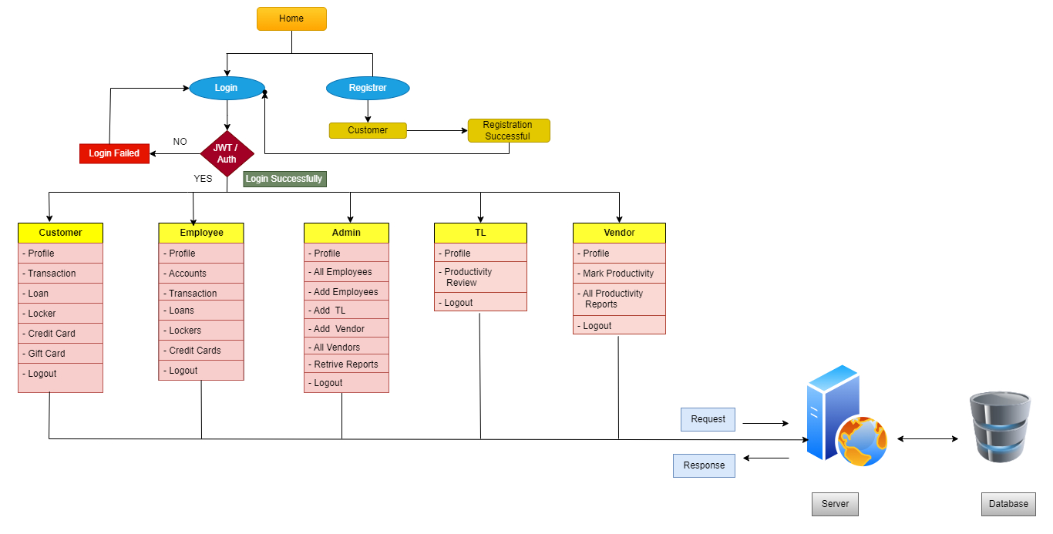
Design Overview

Slide 19








More Functionalities
Email Services
Reset Password
Forgot Password
Chatbot
Eureka Server
API Gateway
ELK
PDF Generation

Slide 20








Tools & Technologies
Spring Tool Suite
Visual Studio Code
Postman
MySQL
Java
React
Gitlab
Browsers

Slide 21
“Banking is not just about loans and deposits. It's about the people we serve and the dreams we help achieve.”

Slide 22

Conclusion
The Apex Banking Portal project has been successfully concluded, meeting all requirements and delivering a secure and user-friendly platform.
We appreciate the collaborative efforts of the team, which enabled us to achieve our goals within the scheduled timeframe.
This project marks a significant step forward in enhancing our banking services and ensuring customer satisfaction.

Slide 23



Our Team
Ashish Dani
Deepak Koshta
Vishal Dohale
(Team Leader)
(Group Member)
(Group Member)

Slide 24




Thank You !
Contact with us :
info.apexbanking@gmail.com

